Slide 1

Machine Learning-Based Approach for Automated Biometric Identification of Mugger
Crocodiles
CSE641 Machine Learning Theory and Practice
Group 5: Shalvi Modi, Daksh Shah, Malav Modi, Mahi Patel, Vinisha Kankariya

Slide 2
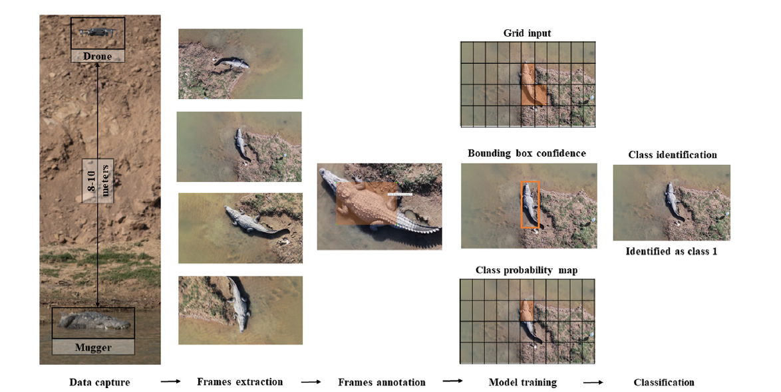

Problem Statement
Using classical machine learning approach for automated biometric identification of Mugger crocodile
Fig.4 [3] Class Identification Flow Chart
[3]Ghosal, Ratna & Shah, Supan & Patel, Arpit & Patel, Vaishwi & Raval, Mehul & Desai, Brinky. (2022). Identification of free-ranging mugger crocodiles by applying deep learning methods on UAV imagery. 10.5061/dryad.s4mw6m98n.

Slide 3
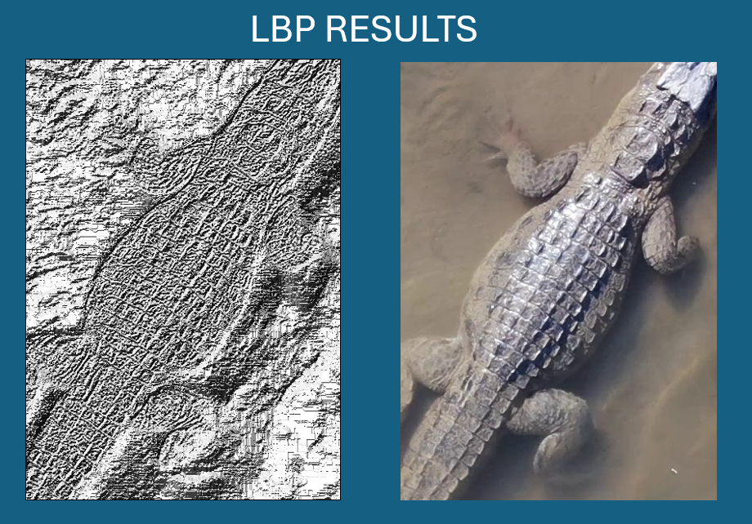
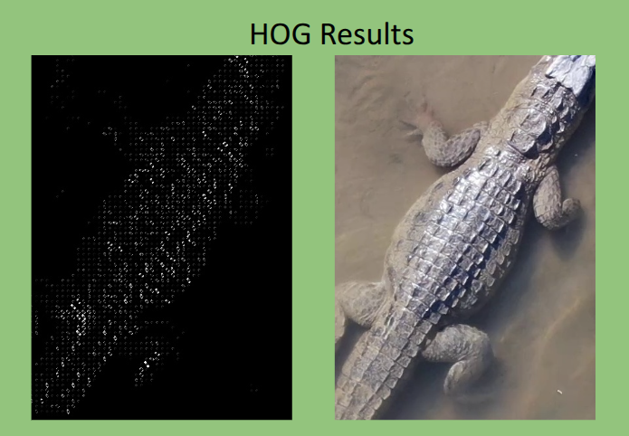
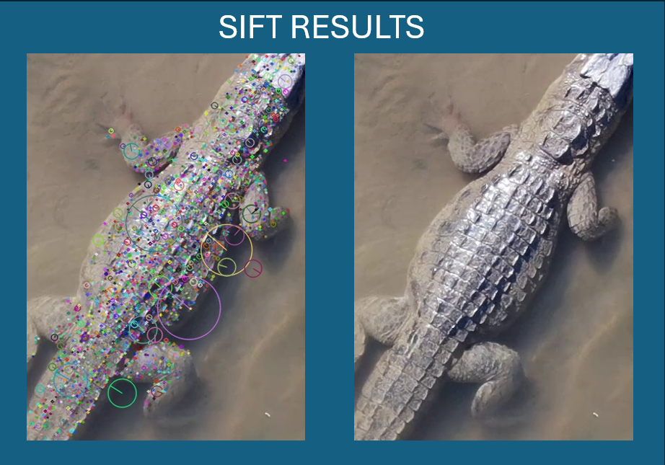
Feedback Received
Merge Features for different feature extraction for improved accuracy
Incorporation of new season data and then verify the accuracy of prediction for the Machine Learning Model
Fig.5 - LBP representation
Fig.6 - HOG representation
Fig.7 - SIFT representation

Slide 4
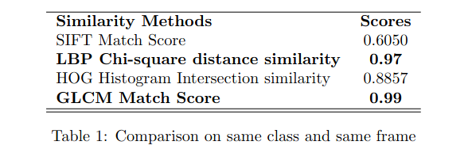
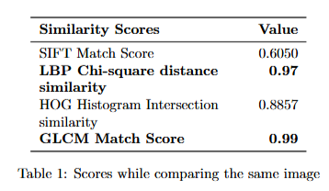
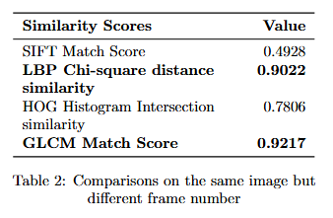
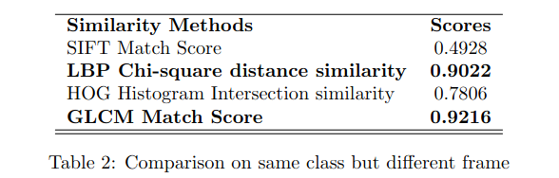
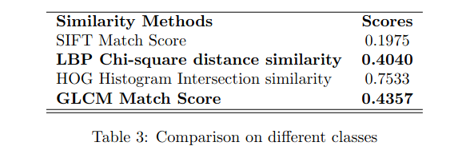
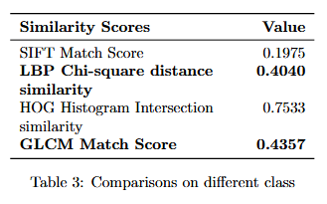
Methodology - Old Approach
We used a pretrained model for bounding box generation, ensuring accurate mugger localization.
Feature extraction methods like SIFT,HOG, LBP, GLCM were applied for better identification. A pretrained model was used for bounding box generation.[3]
Merged the features of GLCM and LBP feature extractors for improving the accuracy of mugger identification.
[3]Ghosal, Ratna & Shah, Supan & Patel, Arpit & Patel, Vaishwi & Raval, Mehul & Desai, Brinky. (2022). Identification of free-ranging mugger crocodiles by applying deep learning methods on UAV imagery. 10.5061/dryad.s4mw6m98n.

Slide 5
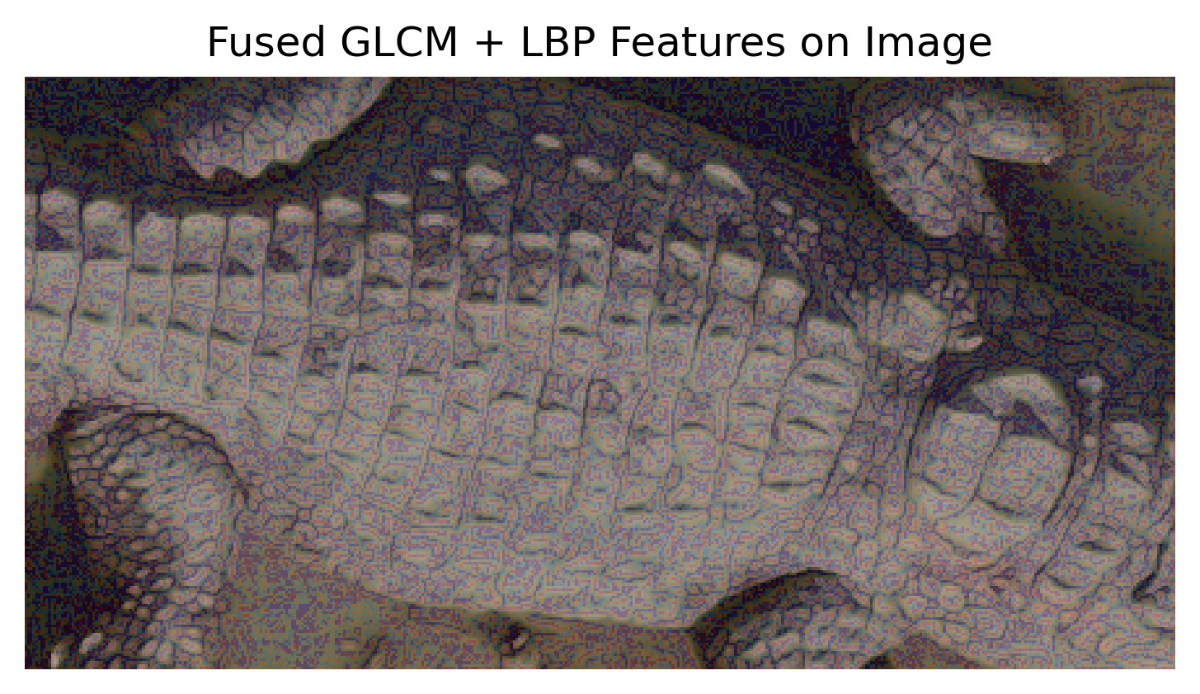
Methodology
Merging the features of GLCM and LBP by Concatenation

Slide 6
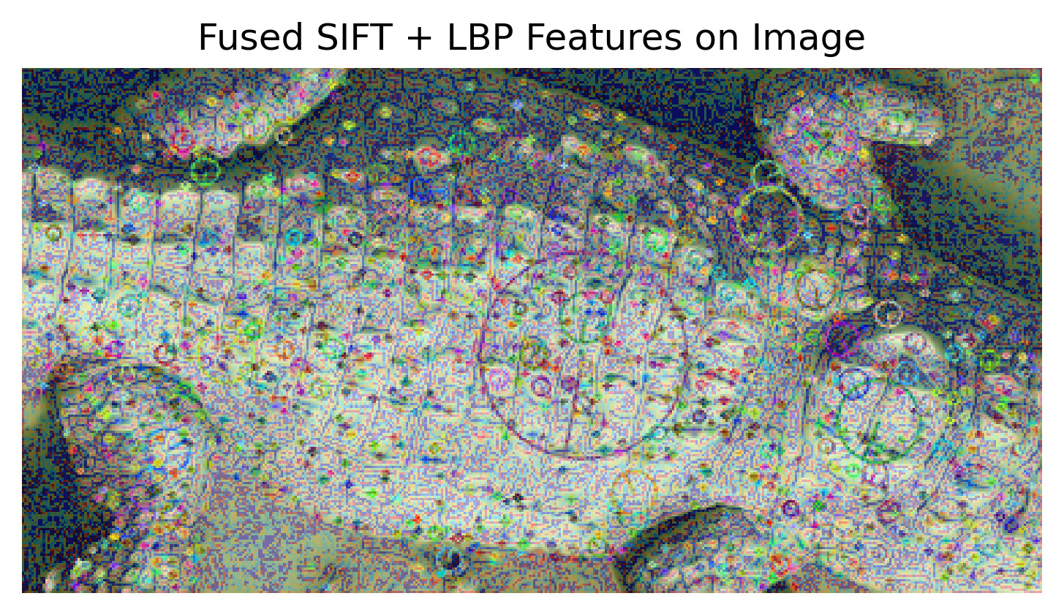
Methodology
Merging the features of SIFT and LBP by Concatenation

Slide 7
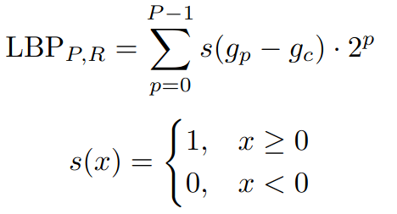
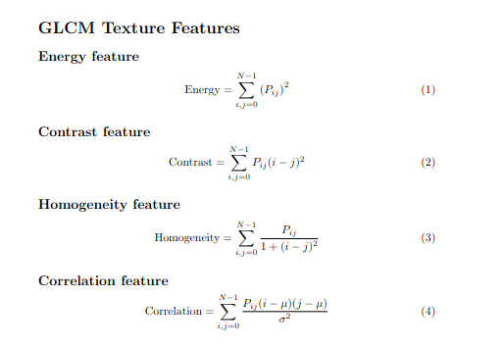
Methodology
LBP - Local Binary Pattern
GLCM - Gray Level Co-occurrence Matrix

Slide 8
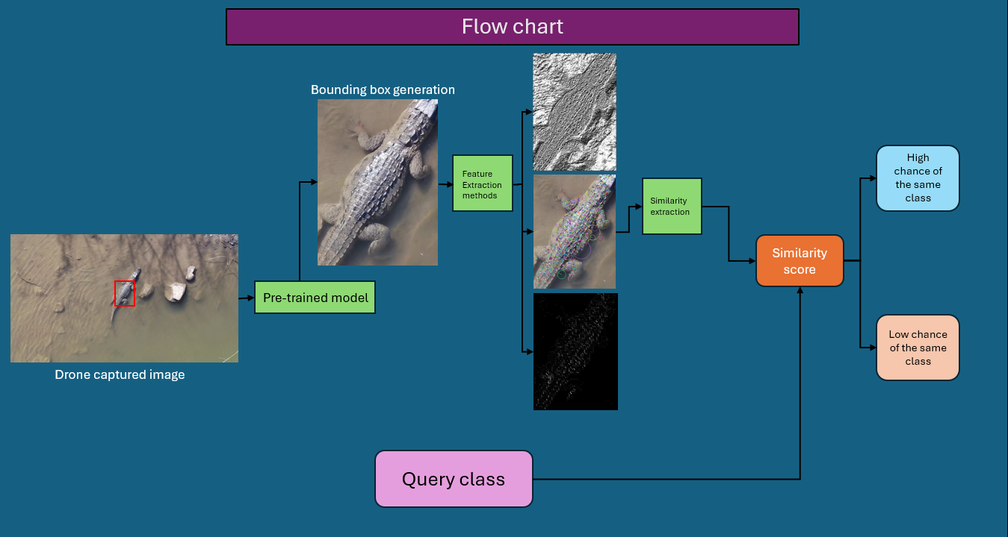
Methodology - Old Approach

Slide 9
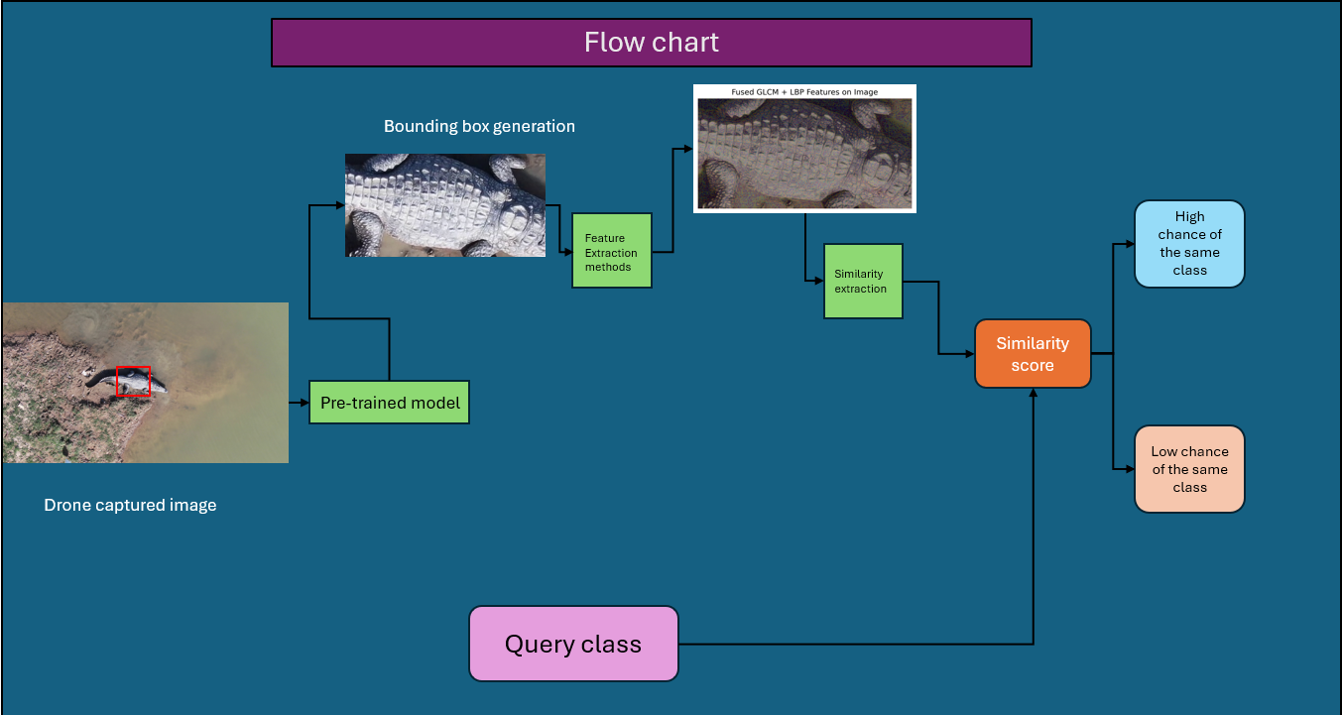
Methodology - New Approach

Slide 10
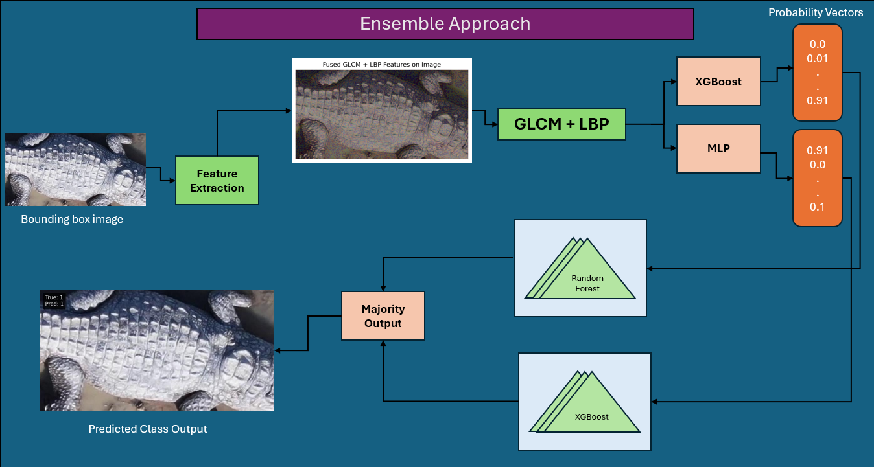
Methodology

Slide 11
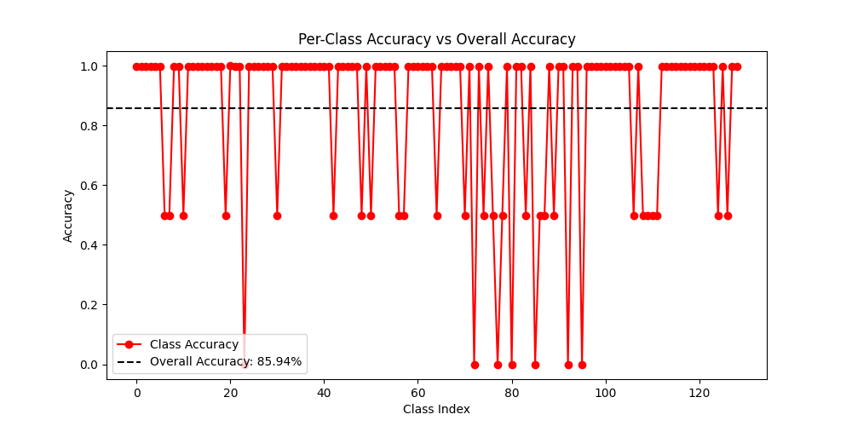
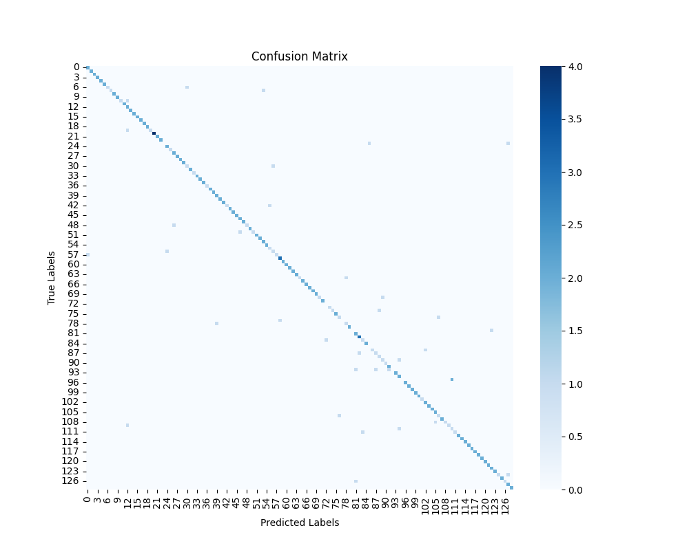
Results - New Data
Fig.8 Per-Class Accuracy vs Overall Accuracy
Fig.9 Confusion Matrix

Slide 12
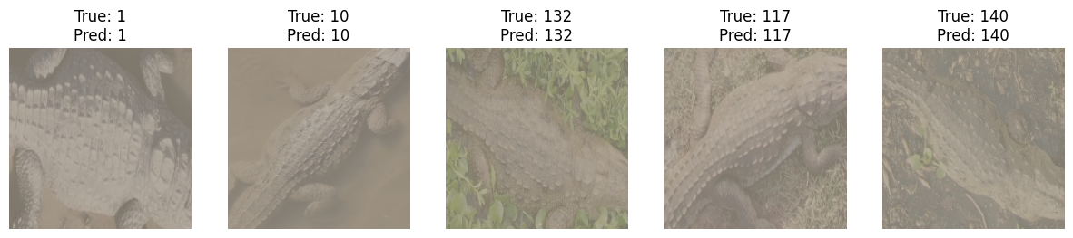
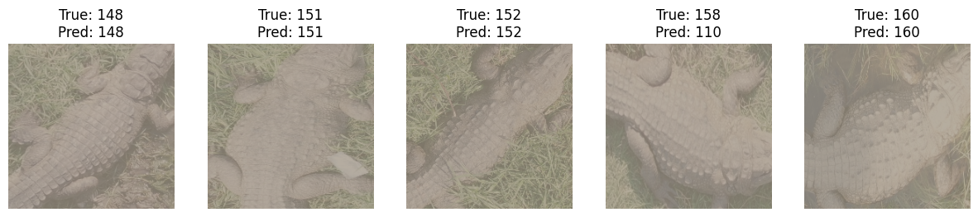
Results
Prediction for Old Data
Prediction for New Season Data

Slide 13
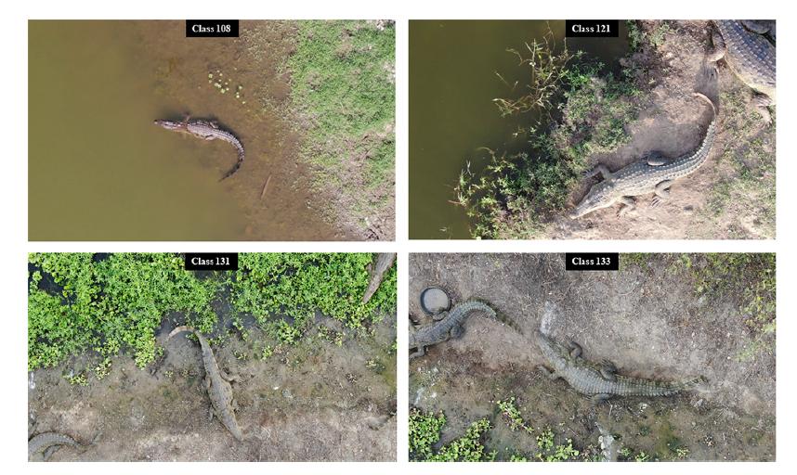
Future Scope
Future work can replace YOLO v11-based bounding box detection with advanced image segmentation methods, enabling more precise localization and improved accuracy in classical machine learning-based mugger identification . Moreover the future work also involves system deployment.
Fig.10 [3]

Slide 14
References
[1]Kokal, S., Vanamala, M., & Dave, R. (2023). Deep Learning and Machine Learning, Better Together Than Apart: A Review on Biometrics Mobile Authentication. Journal of Cybersecurity and Privacy, 3(2), 227-258. https://doi.org/10.3390/jcp3020013
[2]Hossain, Md Ekramul, et al. “A Systematic Review of Machine Learning Techniques for Cattle Identification: Datasets, Methods and Future Directions.” Artificial Intelligence in Agriculture, Sept. 2022, https://doi.org/10.1016/j.aiia.2022.09.002.
[3]Ghosal, Ratna & Shah, Supan & Patel, Arpit & Patel, Vaishwi & Raval, Mehul & Desai, Brinky. (2022). Identification of free-ranging mugger crocodiles by applying deep learning methods on UAV imagery. 10.5061/dryad.s4mw6m98n.
[4]Alexandre Delplanque, Samuel Foucher, Jérôme Théau, Elsa Bussière, Cédric Vermeulen, Philippe Lejeune,From crowd to herd counting: How to precisely detect and count African mammals using aerial imagery and deep learning?,ISPRS Journal of Photogrammetry and Remote Sensing,
[5]Moreni, M., Theau, J., & Foucher, S. (n.d.). Do you get what you see? insights of using map to select architectures of pretrained neural networks for automated aerial animal detection. PLOS ONE. https://journals.plos.org/plosone/article?id=10.1371%2Fjournal.pone.0284449
[6]Multispecies detection and identification of African mammals in aerial imagery using convolutional neural networks - Delplanque - 2022 - remote sensing in ecology and Conservation - Wiley Online Library. (n.d.). https://zslpublications.onlinelibrary.wiley.com/doi/10.1002/rse2.234

